Slide 1
CALCULATOR USING PYTHON(Tkinter)
Presented by:
Surabhi Patil

Slide 2
Introduction:
Python is a popular programming language. It is used for web development, software development, system scripting
Python programming language is very well suited for beginners and experienced programmers who are familiar with other programming languages like C++ and Java
The biggest strength of Python is a huge collection of standard libraries that can be used for the following GUI Applications like Kivy, Tkinter, PyQt, etc

Slide 3
Tkinter:
Tkinter is the standard GUI library for Python
Python when combined with Tkinter provides a fast and easy way to create GUI applications
Tkinter provides a powerful object-oriented interface to the Tk GUI toolkit

Slide 4
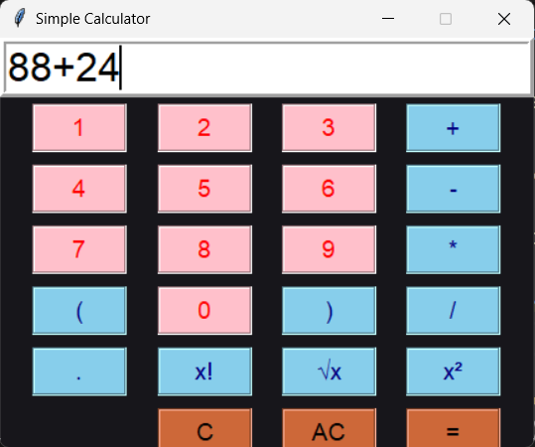
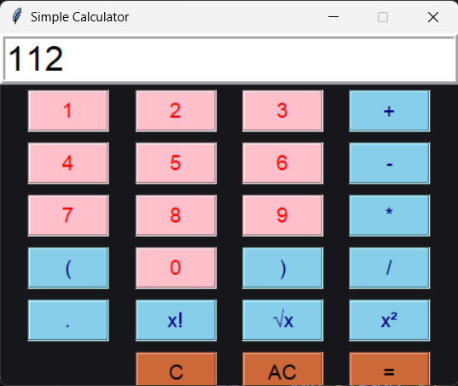
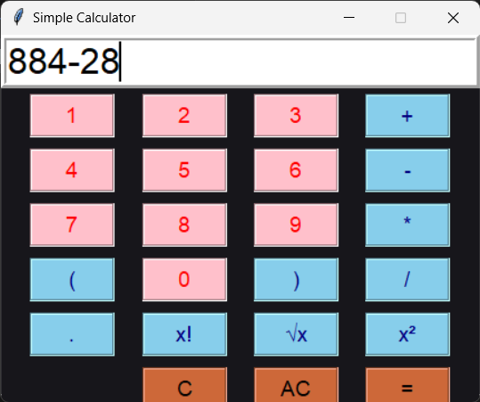
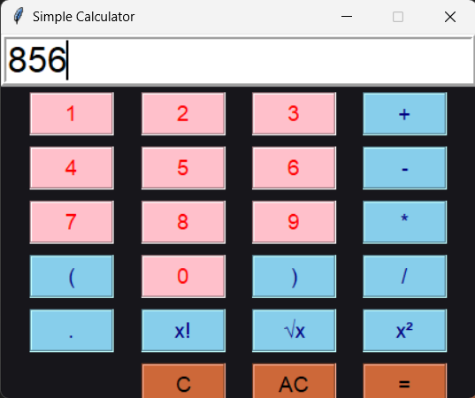
Output:
Addition:
Subtraction:

Slide 5
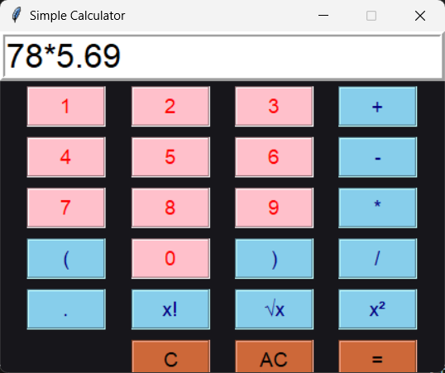
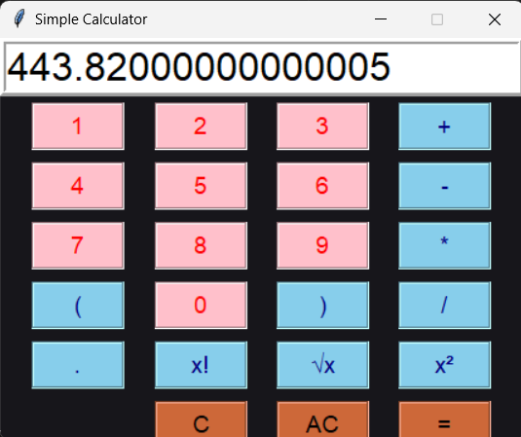
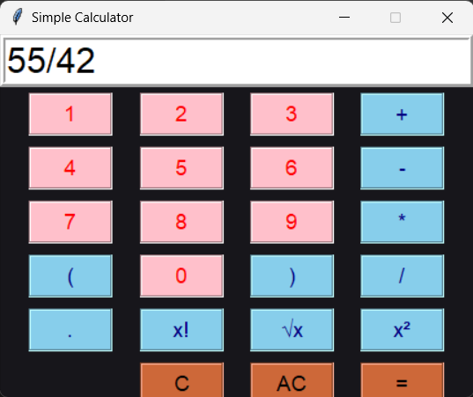
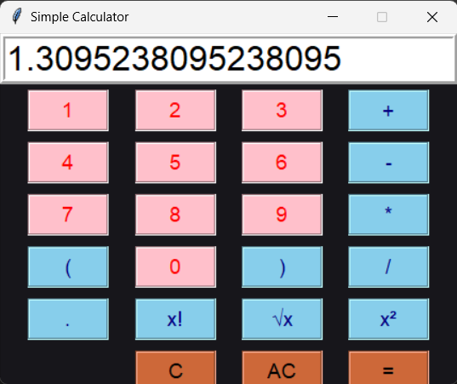
Multiplication:
Division:

Slide 6
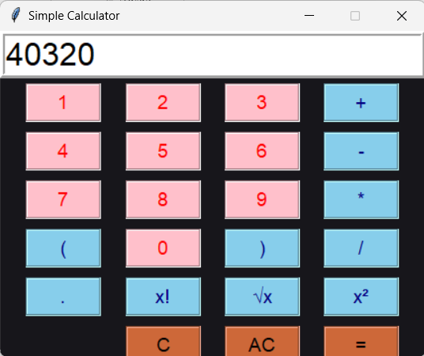


Factorial of 8:
(8!)
The square root of 81:
(√81)
Square of 64:
(64²)

Slide 7
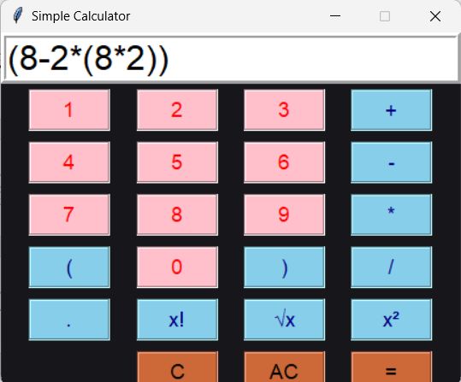
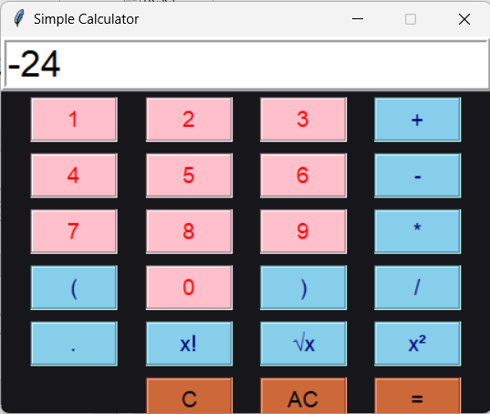
Using multiple brackets:

Slide 8
THANK YOU

